Slide 1
Capita Selecta SE
Online ticketing

Slide 2
Modelling of the system

Slide 3
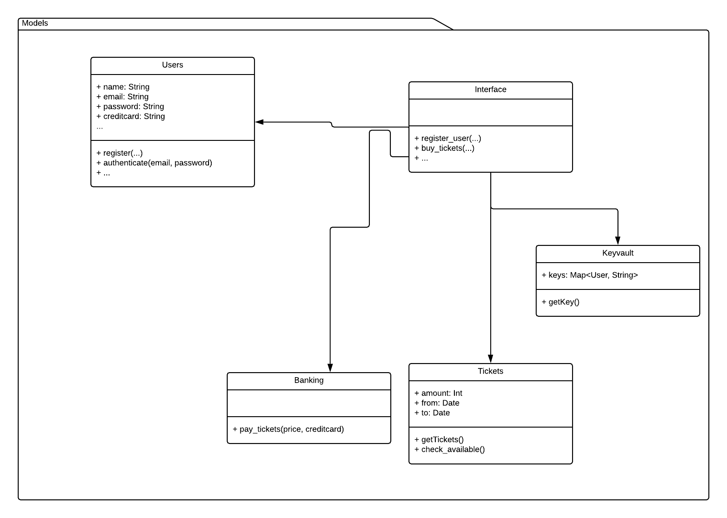

Slide 4
Differences
Added Tickets service
Changed working logic

Slide 5
Sequence diagrams
See blackboard

Slide 6
Model callibration
Banking duration: use random numbers to determine success
Keyvault duration: constant factor (potential bottleneck)

